Slide 1
Leave No Trace
Teaching Resources

Slide 2
Resources From
Leave No Trace
Master Educator Handbook!
Education & Training Resources Page
Concepts and Plans For Teaching Leave No Trace web Page

Slide 3

Resources From
Leave No Trace
Skills & Ethics Handbooks
  Alaska Wildlands
  Caving
  Deserts and Canyons (downloadable)
  Fishing
  Horse Use
  Lakes Region
  Mountain Biking
  North America (downloadable PDF)
  North America - Spanish
  Northeast Mountains
  Pacific Northwest
  Rock Climbing
  Rocky Mountains (downloadable)
  Sea Kayaking
  Sierra Nevada
  Southeast
  Western River Corridors

Slide 4
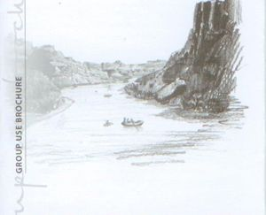
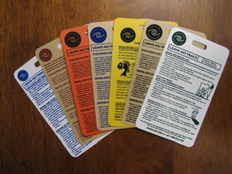

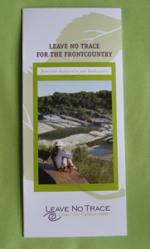
Resources From
Leave No Trace
Pamphlets & Brochures
    Group Use Brochure (PDF available)
    Ethics Reference Cards (Hang Tags)
    Pocket Guide
    Frontcountry Guide

Slide 5
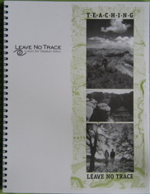
Resources From
Leave No Trace
Activity Guide, Teaching Leave No Trace

Slide 6

Resources From
Leave No Trace
101 Ways to Teach Leave No Trace

Slide 7

Resources From
Leave No Trace
Bigfoot’s Playbook

Slide 8
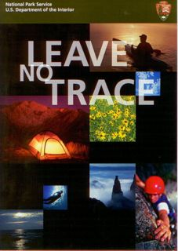
Resources From
Leave No Trace
Videos
    NPS Leave No Trace DVD
    Viewable (and downloadable)
    at NPS website
    Many Videos on YouTube

Slide 9
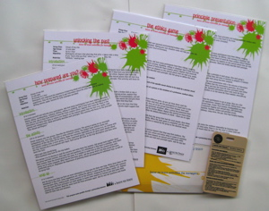


Resources From
Leave No Trace
Peak Pack / Teen Pack
  Designed to teach kids 6-12 years old
  Each module about 30-60 minutes
  Designed to be easy to facilitate
  Additional Modules available
  Teen Activity Pack available

Slide 10



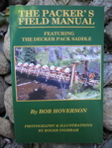
Resources From
Leave No Trace
Books
  BACKPACKER Leave No Trace
  Falcon Guide to Leave No Trace
  Wilderness Ethics
  The Backpackers’s Field Manual
  ….

Slide 11
Resources From
Leave No Trace
Online Leave No Trace 101 Course

Slide 12
Resources From
Leave No Trace
Leave No Trace Related Research
web Page
https://lnt.org/research-resources/leave-no-trace-focused-research-2011-2018/

Slide 13
Resources From
Leave No Trace
Programs
  (See other slideset)

Slide 14
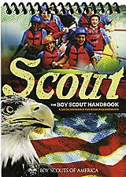


Resources From the
Boy Scouts of America
Scouts BSA Handbooks (and Cub Scout)
BSA Fieldbook
Passport to High Adventure
OE Guide (& Advisor) Handbook

Slide 15

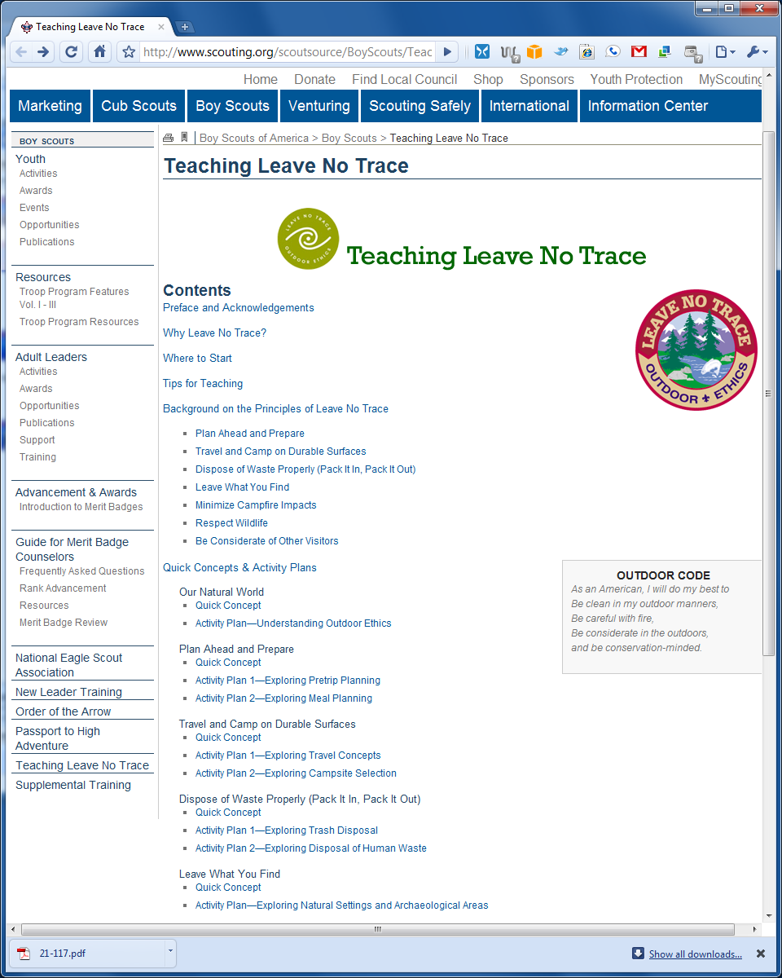
Resources From the
Boy Scouts of America
Teaching Leave No Trace
(web page & downloadable)

Slide 16
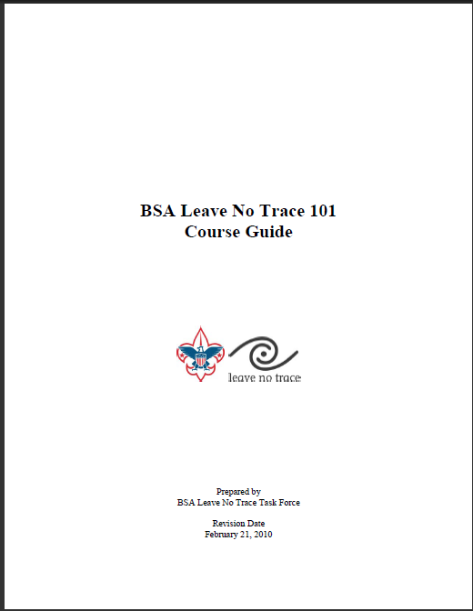
Resources From the BSA Outdoor Ethics Committee
BSA Leave No Trace 101 Course Guide

Slide 17
Resources From the BSA Outdoor Ethics Committee
BSA Leave No Trace Level 1 Instructor Course Manual

Slide 18
Resources From the BSA Outdoor Ethics Committee
BSA Supplement to the Leave No Trace Master Educator Handbook

Slide 19
Resources From the BSA Outdoor Ethics Committee
BSA Outdoor Programs / Outdoor Ethics
  https://www.scouting.org/outdoor-programs/outdoor-ethics/
  http://outdoorethics-bsa.org/news/

Slide 20

Resources From the BSA Outdoor Ethics Committee
Council Outdoor Ethics Advocate

Slide 21
The End

Slide 22
Revisions
This slide set was originally developed by Dan Thompson of the Blue Grass Council for the Boy Scouts of America Outdoor Ethics Task Force Master Educator Course.
It is maintained by the BSA Outdoor Ethics and Conservation Subcommittee.
Updated 5/2021 and 6/2022
Please send suggestions & updates to: webmaster@outdoorethics-bsa.org

